Slide 1

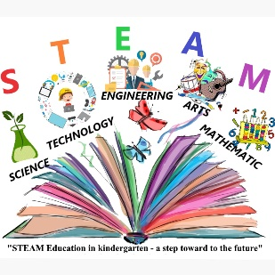



ЧРД
LTT "Involving parents for effective STEAM training”
15-20.06.2022
Debar, Macedonia

Slide 2

Present
Implemented activities in science module

Slide 3

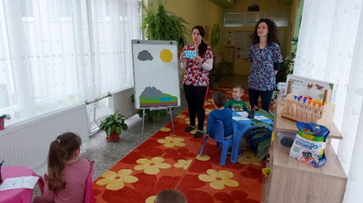
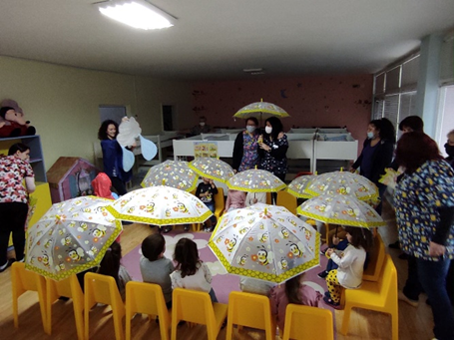
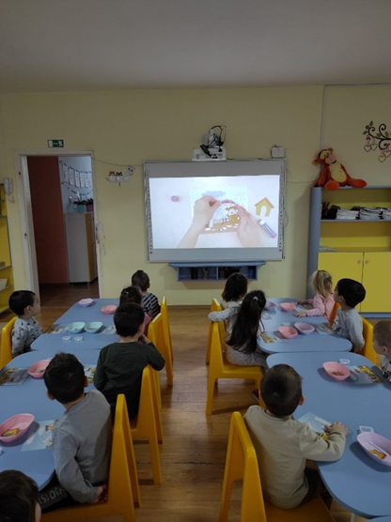
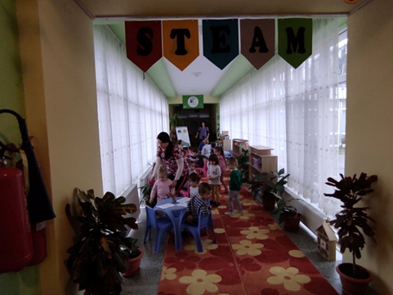
Open lessons were held in all age groups
"In the rain" / 3 years /

Slide 4
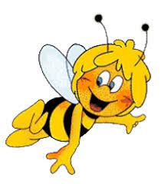
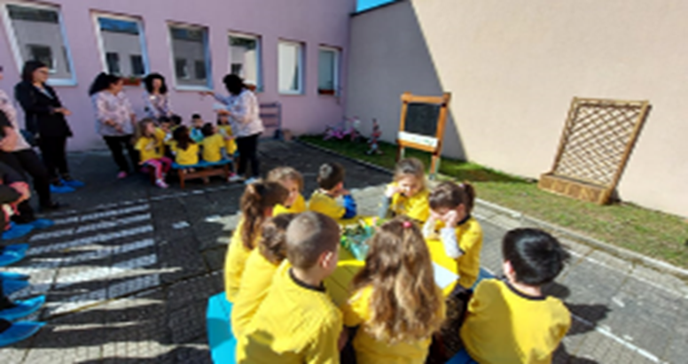
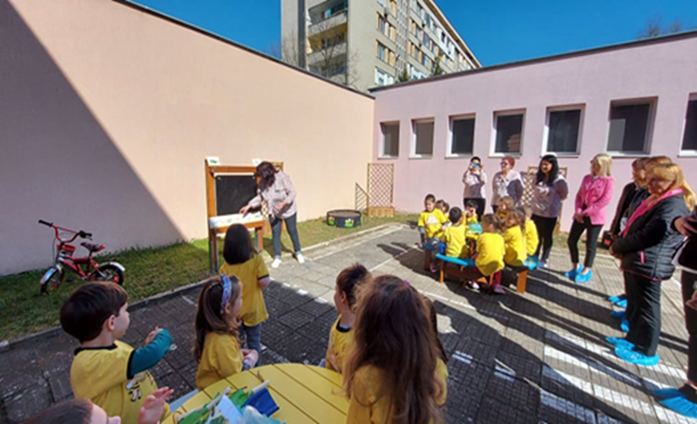
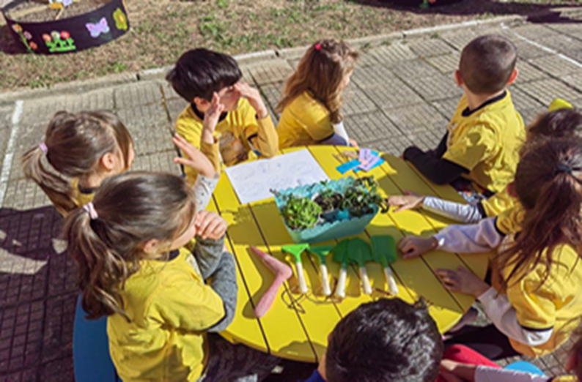
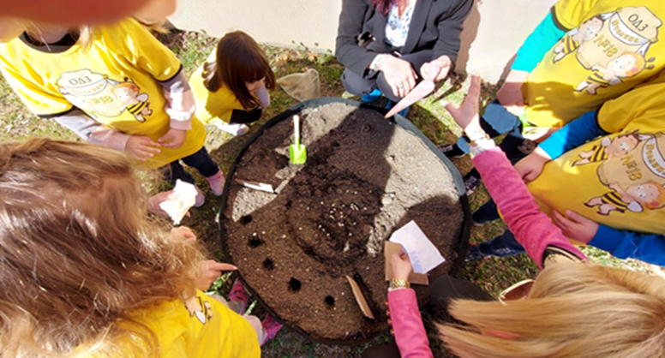
"Garden“ 4-year-olds

Slide 5
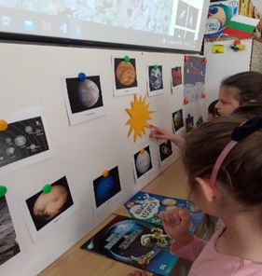
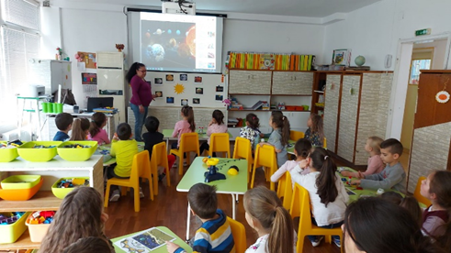
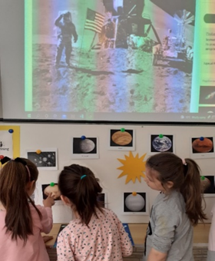
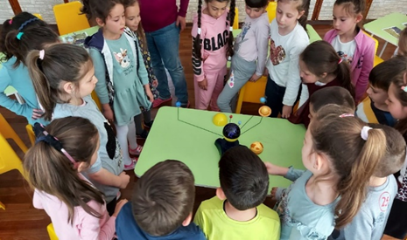
“A Space Walk” /6-year-olds/

Slide 6

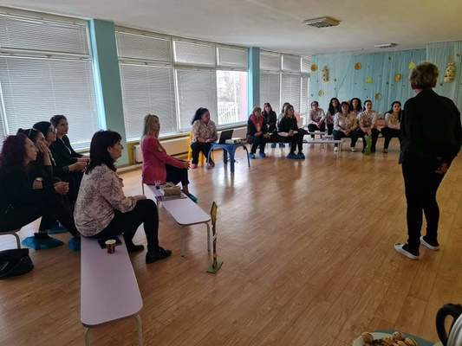
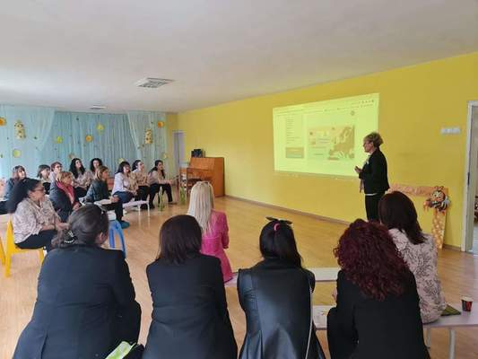
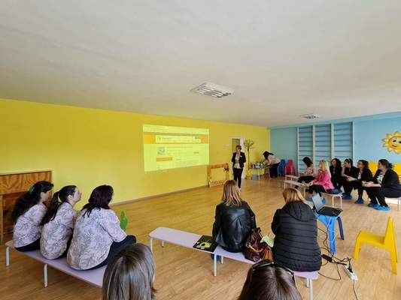
On April 5, 2022 in Pchelitsa Kindergarten was held "Thematic seminar “STEAM based training in kindergarten, a step toward to the future" The seminar was held together with Kindergarten "Zornitsa" Karlovo

Slide 7
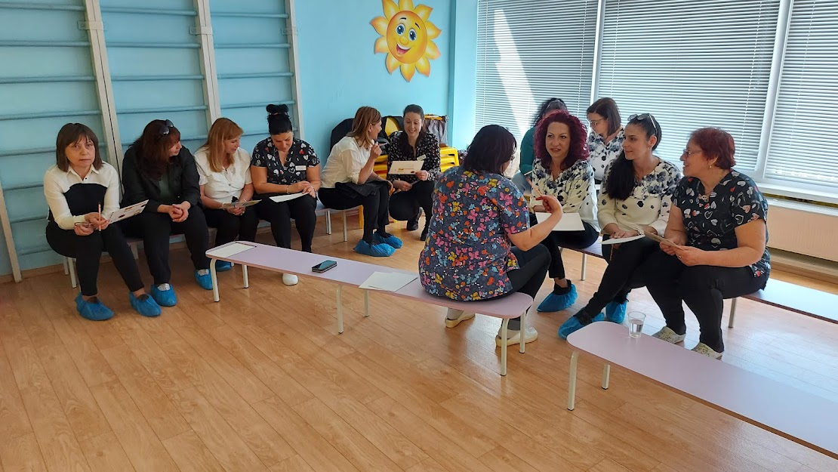
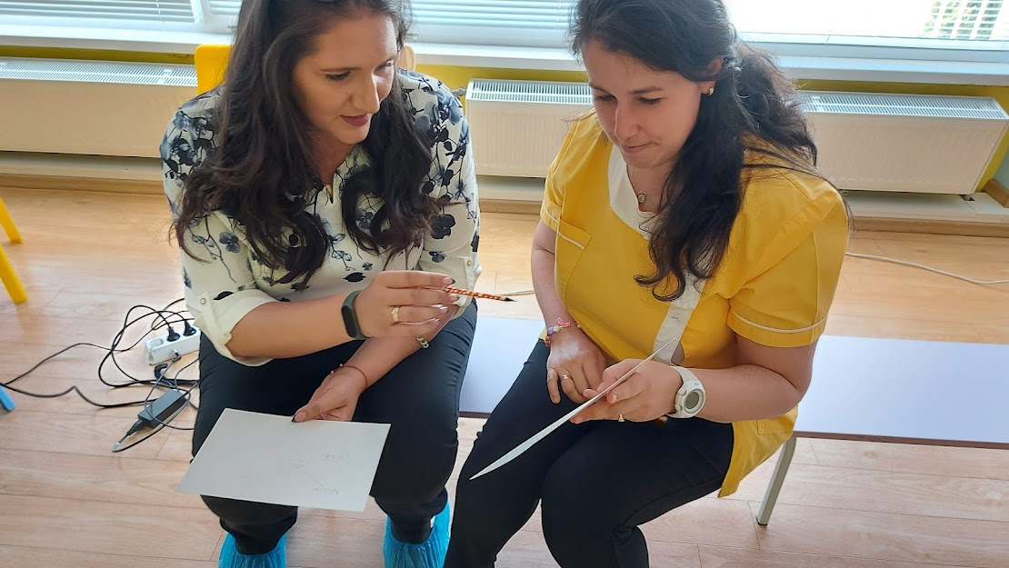
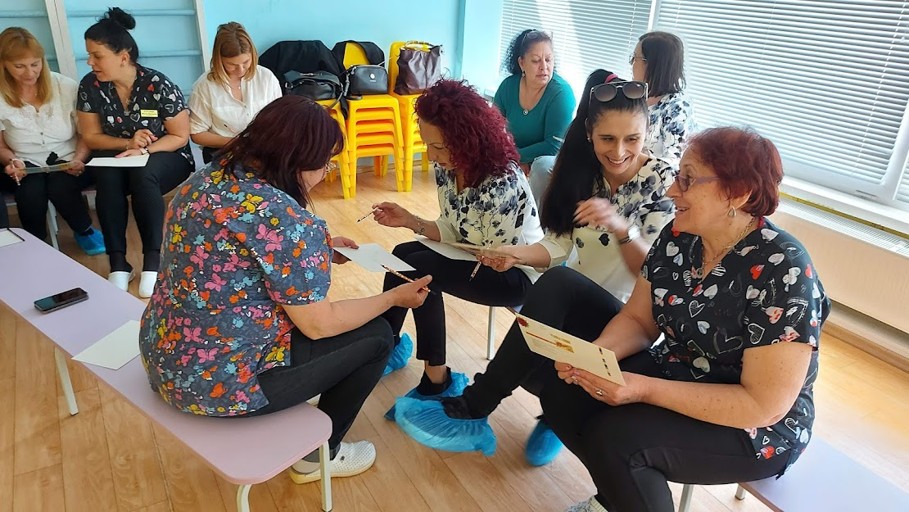

Slide 8

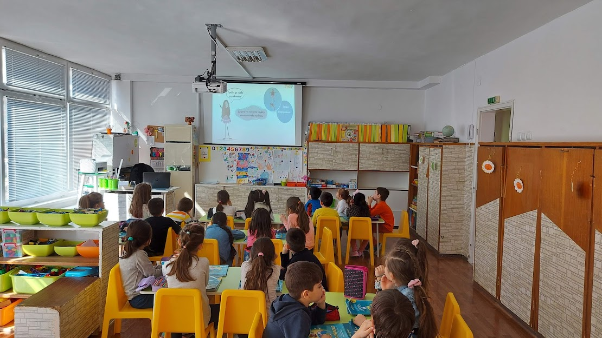
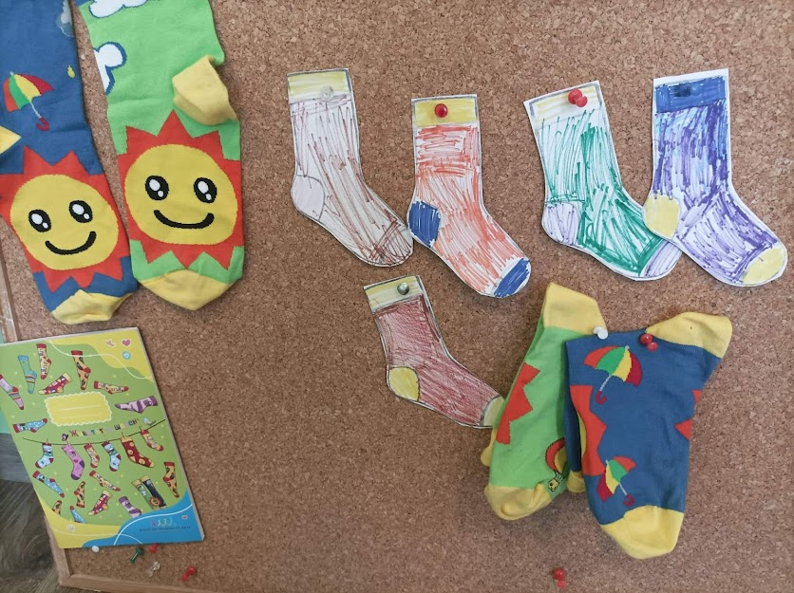
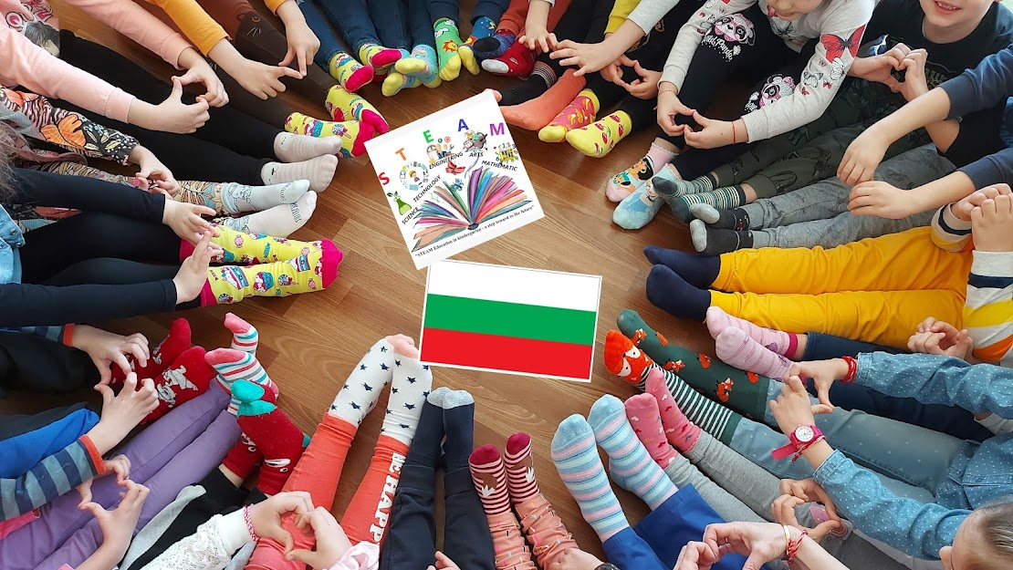
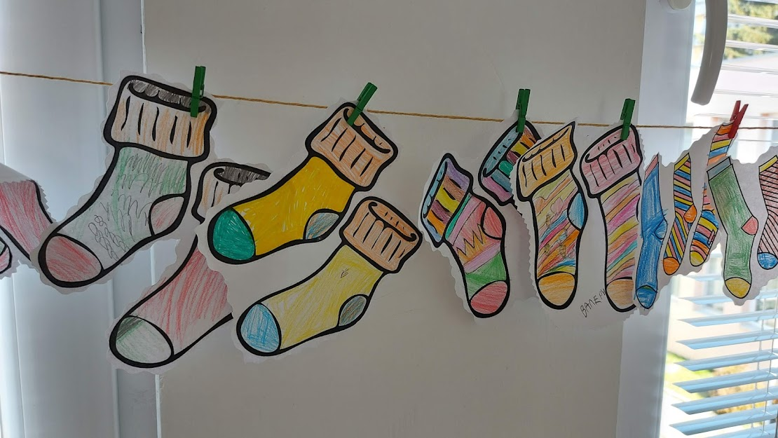
We celebrated March 21, International Day of People with Dawn Syndrome

Slide 9
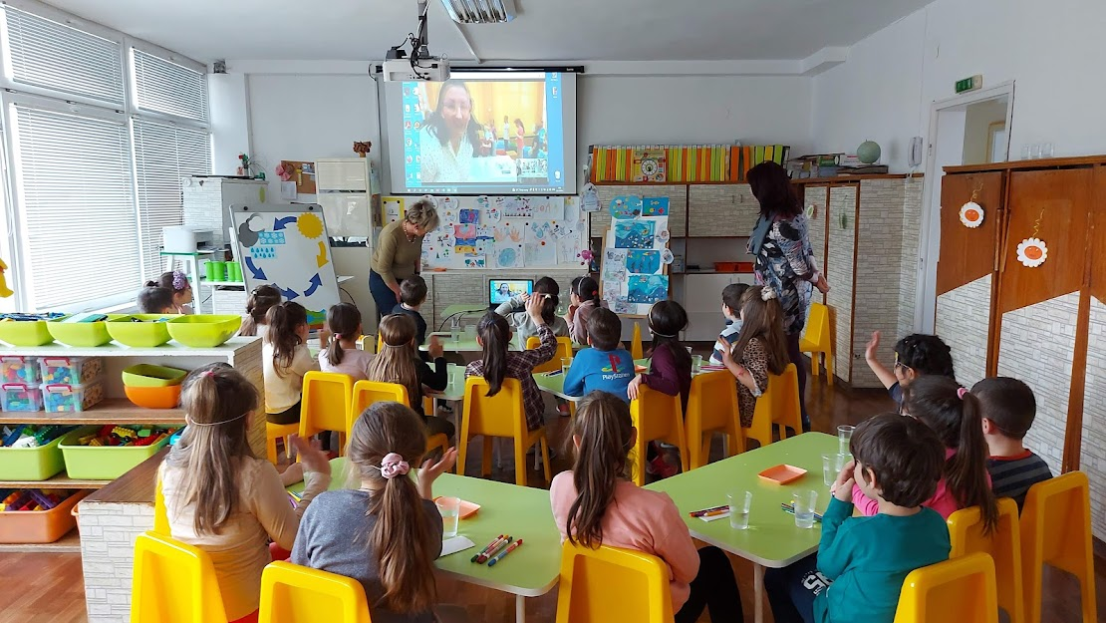
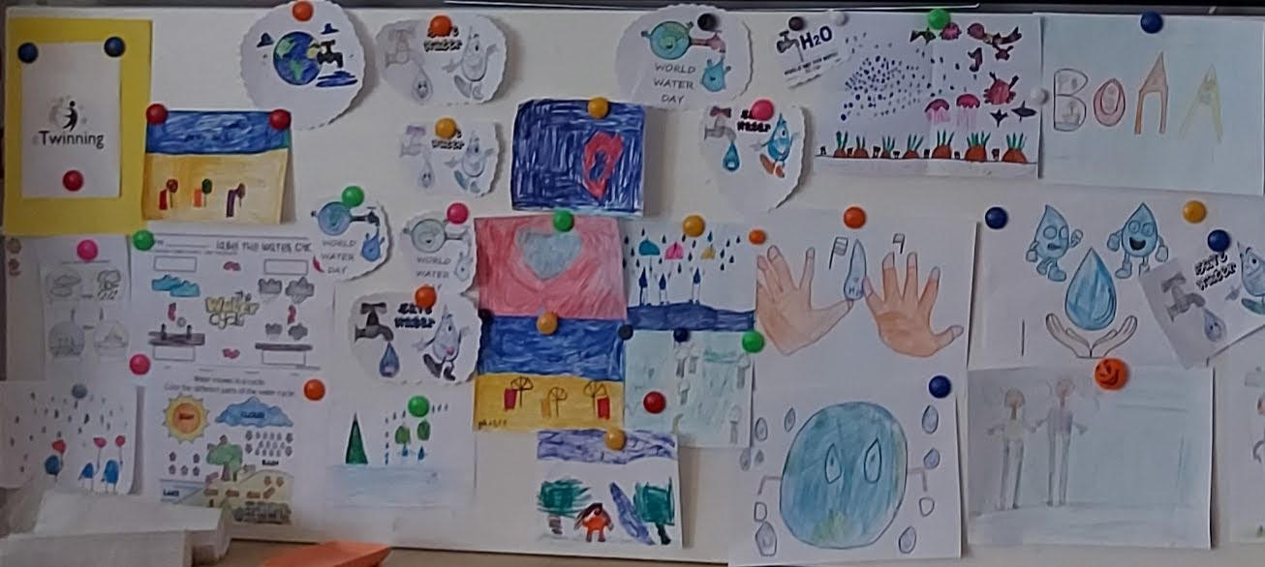
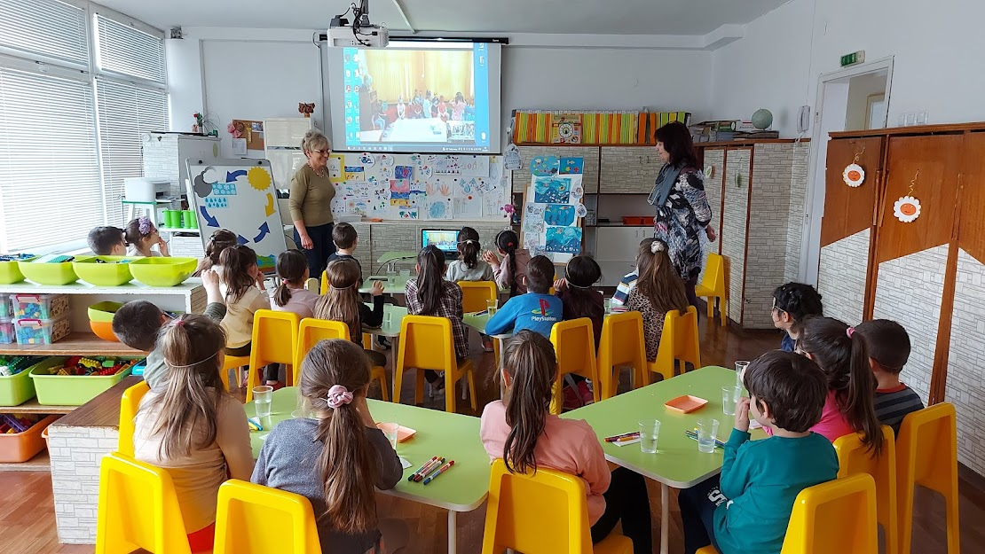
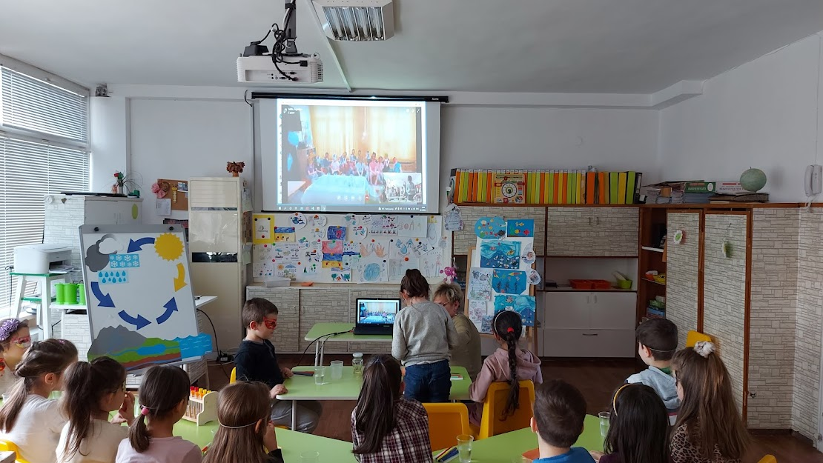
We celebrated World Water Day with many experiments and a joint online meeting with our Polish friends. We had fun, but we learned a lot about water

Slide 10
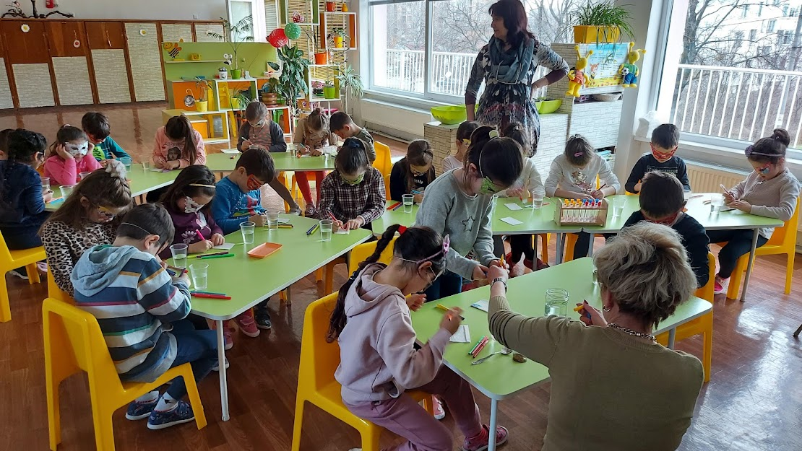
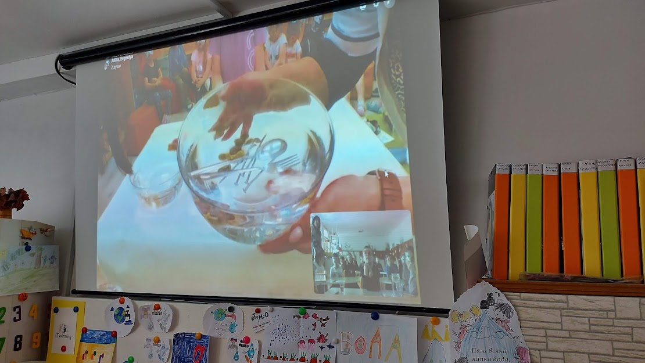
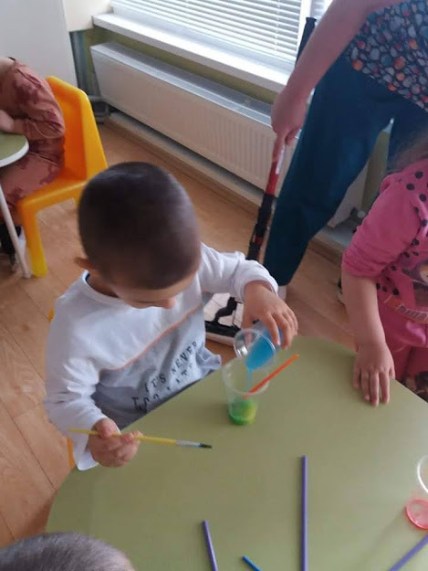
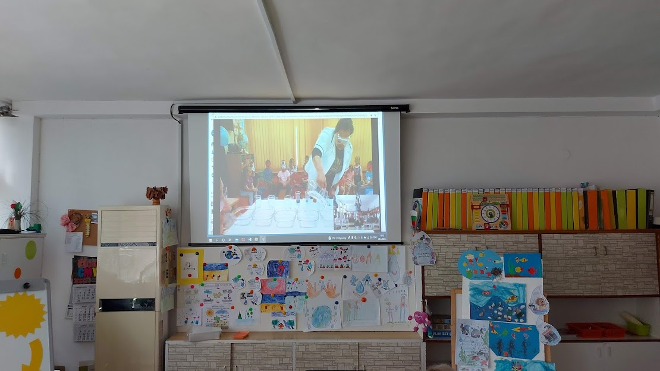

Slide 11
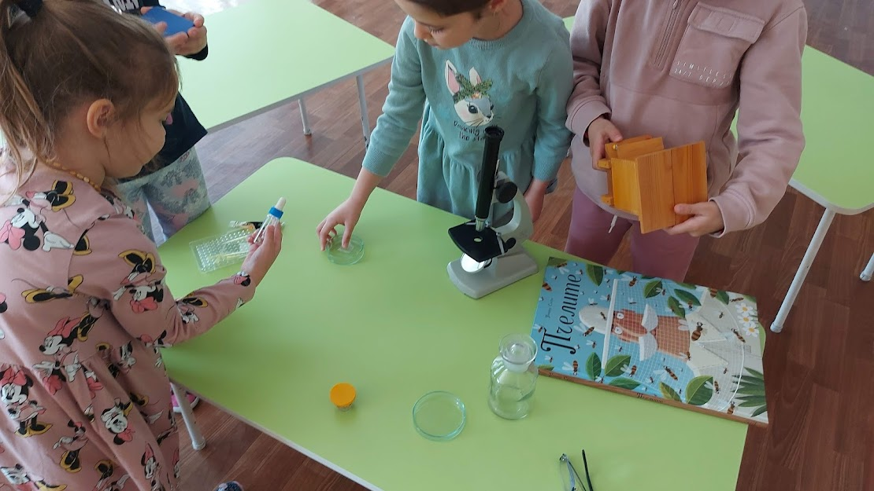
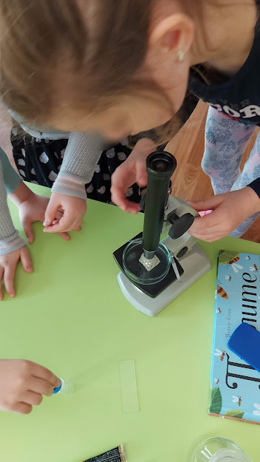
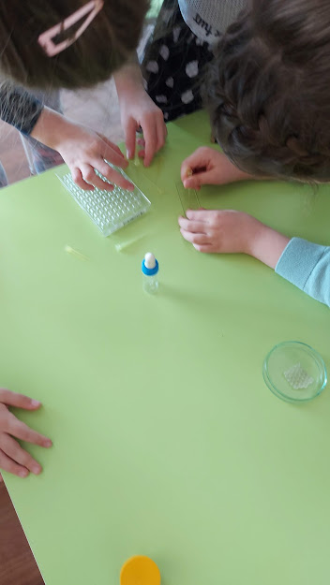
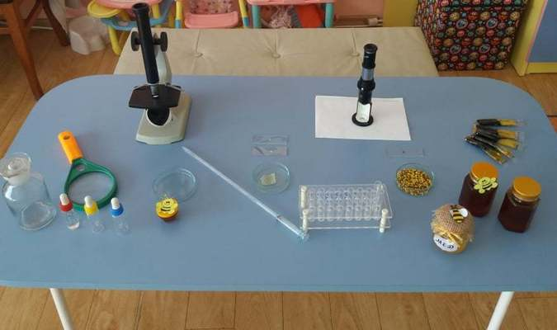
We organized ‘’Pchelitca’’ Laboratory, where we learned a lot about the life of bees, the products they create and their benefits for human health.

Slide 12
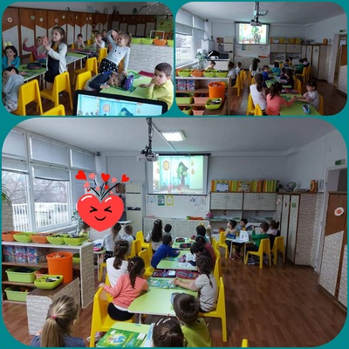
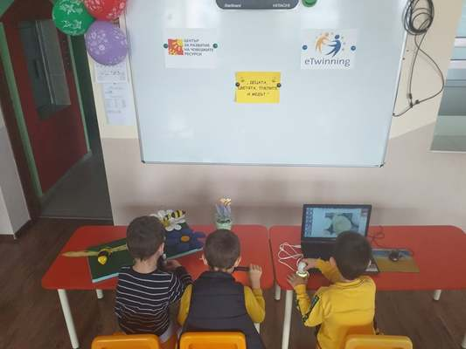
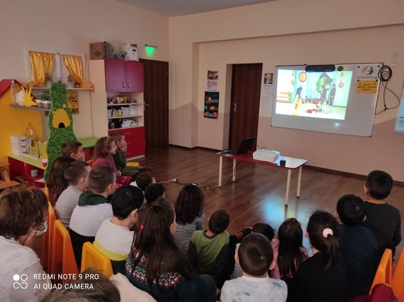
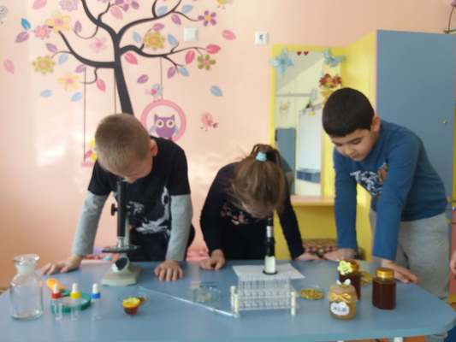
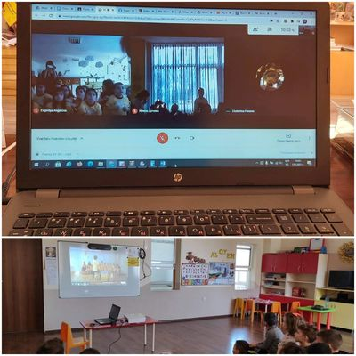
Together with two other kindergartens named Pchelitsa, we organized online meetings "Training beehive"

Slide 13
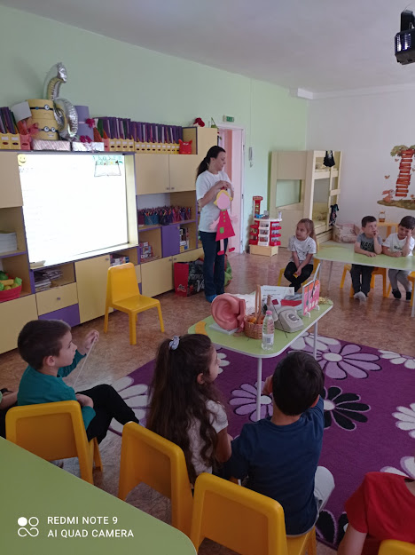
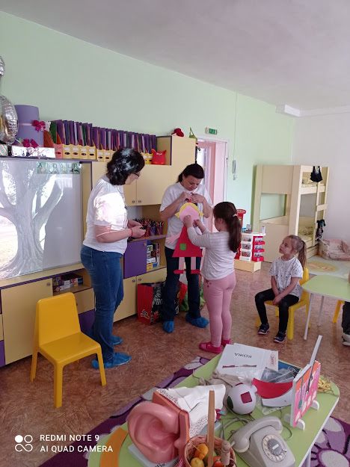
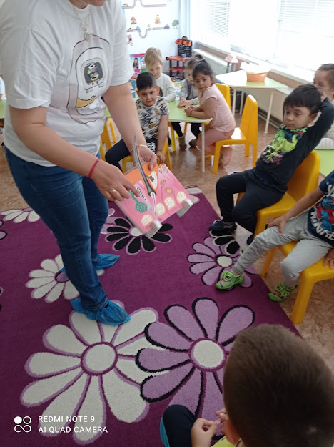
"Museum in a suitcase"
We know that sometimes it is difficult for everyone to visit museum in person.
Therefore, we invited the museum to us!
National Polytechnic Museum

Slide 14
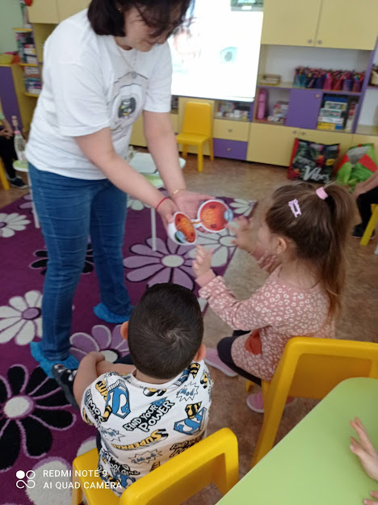
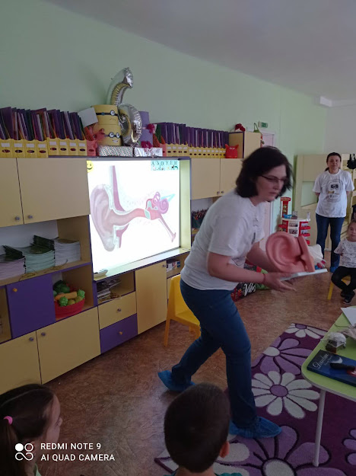
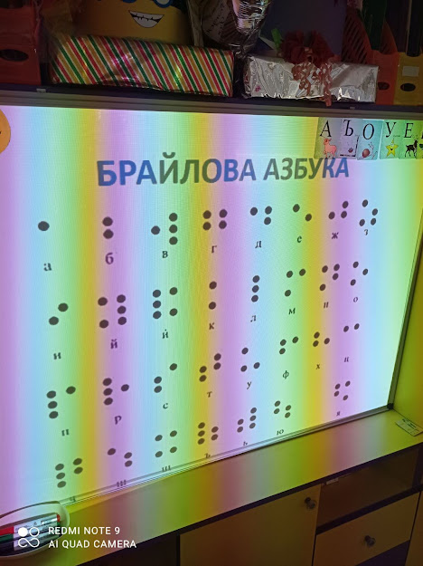

Slide 15


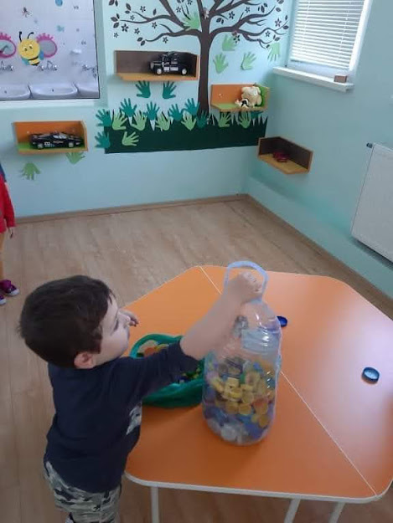
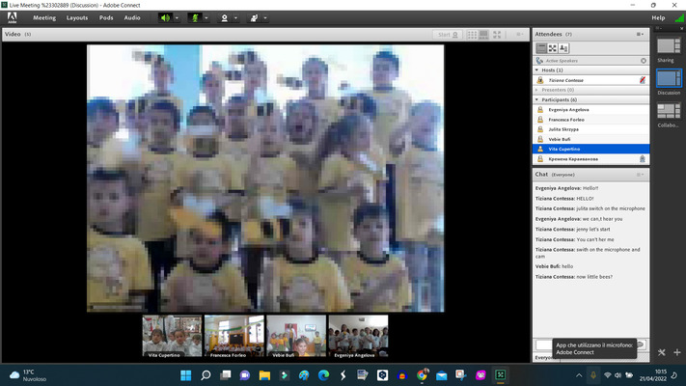
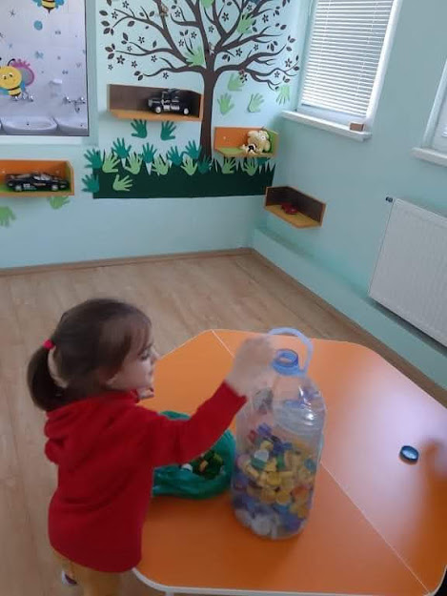
EARTH DAY
The activities were implemented by children from all groups, their teachers, with the active support of parents.
EARTH DAY eTwinning Event

Slide 16






Slide 17


Slide 18





Slide 19



We were explorers …

Slide 20



Slide 21


Slide 22


Slide 23

„IF SOMETHING IS DIFFICULT, IF SOMETHING DOESN'T WORK – FIND A SMALL SEED!
WATER IT WITH GOODNESS, TAKE CARE OF IT WITH LOVE AND HOPE WILL GROW IN YOUR LIFE.
HOW LITTLE DO WE NEED TO SOW LOVE! ”

Slide 24
Author's photos are used in the presentation.
The activities are realized by the whole team of kindergarten Pchelitsa - children, teachers, parents.
Evgenia Angelova summarized and presented all this to you!
Thank you for your attention!

