Slide 1




Results from Meeting Evaluation Form : LTT meeting "Steam learning in the kindergarten - nature, principles and methods of implementation"-Kazanlak, Bulgaria
16-20 May 2022

Slide 2
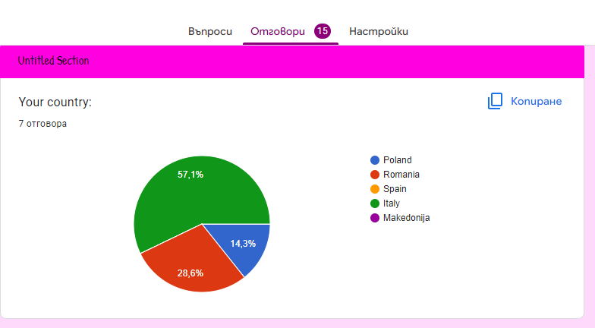
Your country:

Slide 3
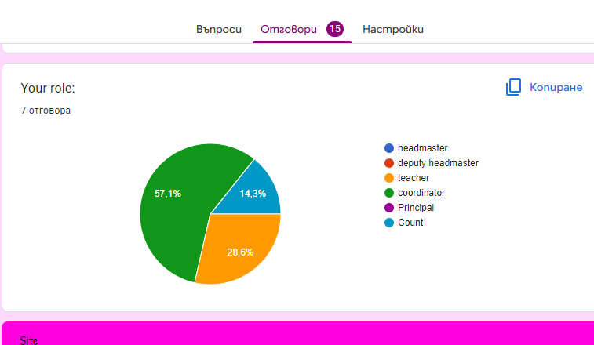
Your role:

Slide 4
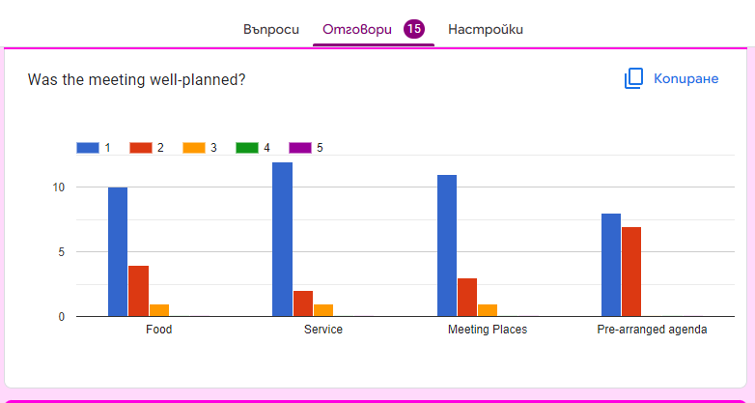
Was the meeting well-planned?
1= Excellent, 2= Good, 3=Average, 4=Fair, 5= Poor

Slide 5
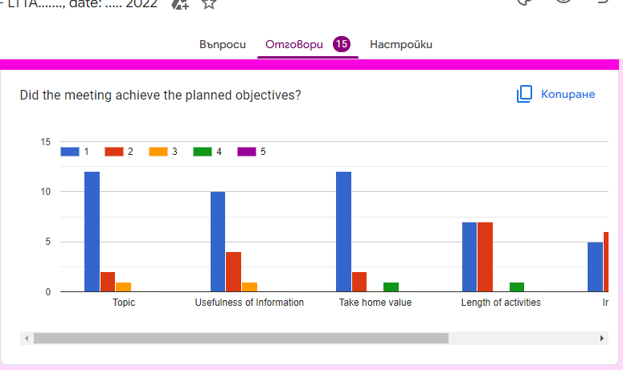
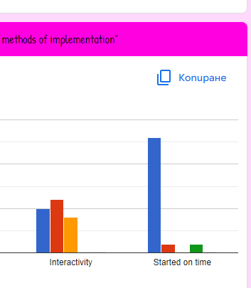
Did the meeting achieve the planned objectives?
1= Excellent, 2= Good, 3=Average, 4=Fair, 5= Poor

Slide 6
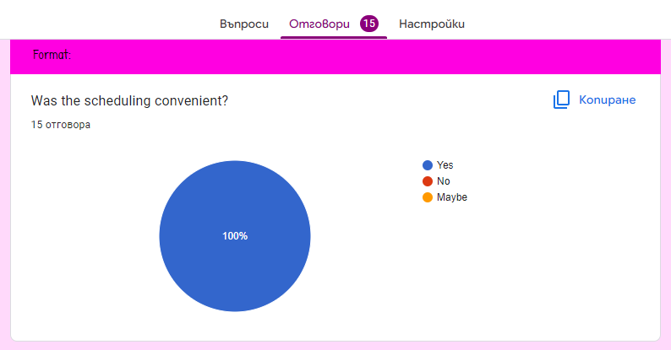
Was the scheduling convenient?

Slide 7
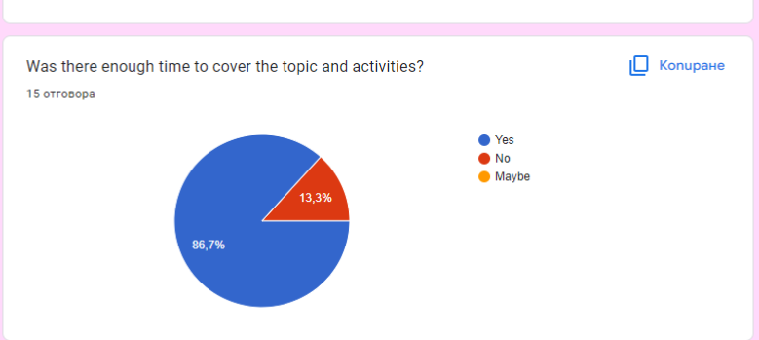
Was there enough time to cover the topic and activities?

Slide 8
Do you have any suggestions or additional comments about this meeting?
Do you have any suggestions or additional comments about this meeting?
15 отговора
No
no
I have no suggest .I think there was an remarkable work to organize everything!👍😘
Perhaps, we should have one or two days with more free time. But in general, I think we have had a great organitation, and Bulgarian team have done a big efford to make us feel delighed.
Thank you for everything!
Amazing and warm hospitality.
Useful activïty planning.
Remarkable organization!
No I don't have any suggestions
Everything was so good but, sometimes, it was quite difficult to order the food in advance, althought the food was delicious
More free time
We appreciate very much the great effort you did to organize this meeting. As a proposal I would say that I think it is no necessary to have all meals arranged in advance, so you can rest some periods during the week and we can also decide about it. Anyway, we are so grateful for your warm welcoming and happy to have met you all. Thanks a lot!
No, i don't have any suggestions

Slide 9
Ideas:
Visit art gallery
Maybe It would be nice to visit a science museum
Visit something with science and technology
Visit sites of importance related to STEAM
Choose the meet in the same restaurant
Related to choose our menu for diner or lunch, it could be the day before or when we will be al the restaurant.
Thanks so much for this experience!
To create a document with all the activities to be done and be finished for the next mobility. Thanks!!!!
Maybe we could have more free time but it is only a suggestion because everybody was so kind and the activities were nice. Thanks for eveything.
Have a quick list of activities and decisions we were sharen to do for the next meeting.
Maybe if it is possible to visit a science museum.
Visit art gallery
Choose the meet in the same restaurant
To create a document with all the activities to be done and be finished for the next mobility. Thanks!!!!
A little more free time
Maybe It would be nice to visit a science museum

Slide 10
I expect the other 3 participants in the meeting to find a few minutes to answer!
I hope that every next meeting will be better organized, correcting the shortcomings!
Thank you!
Evgeniya and the whole Bulgarian team

